Slide 1

Reproducible Clinical Data Analysis with R and RStudio
Welcome to
Please check your e-mail for files we will use in the session
Wireless network: phswifi3 not phspiaguest! Password: Your Partners Password

Slide 2
Reproducible Clinical Data Analysis with R and RStudio
Welcome to
Please check your e-mail for files we will use in the session
Interactive R Command Prompt
Wireless network: phswifi3 not phspiaguest! Password: Your Partners Password

Slide 3
Reproducible Clinical Data Analysis with R and RStudio
Welcome to
Please check your e-mail for files we will use in the session
Editable
Notebook
Data
Overview
Interactive R Command Prompt
Wireless network: phswifi3 not phspiaguest! Password: Your Partners Password

Slide 4
Reproducible Clinical Data Analysis with R and RStudio
Welcome to
Please check your e-mail for files we will use in the session
Editable
Notebook
Data
Overview
Interactive R Command Prompt
Wireless network: phswifi3 not phspiaguest! Password: Your Partners Password

Slide 5
Reproducible Clinical Data Analysis with R and RStudio
Welcome to
Please check your e-mail for files we will use in the session
Editable
Notebook
Data
Overview
Interactive R Command Prompt
Rendered Reproducible Report
Wireless network: phswifi3 not phspiaguest! Password: Your Partners Password

Slide 6
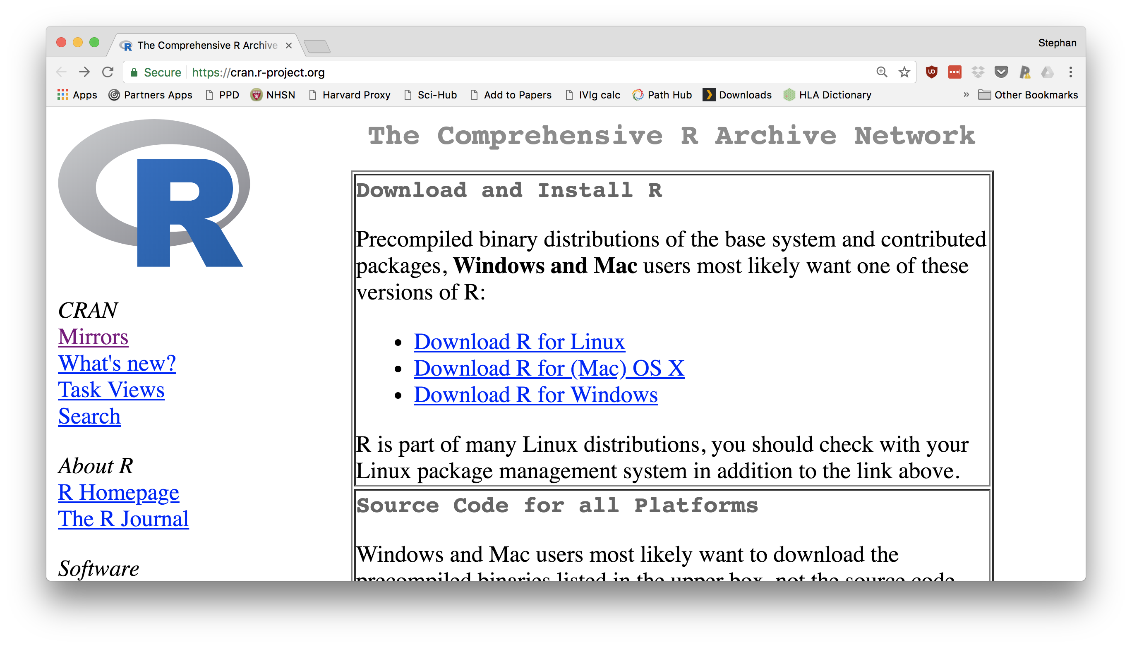
Reproducible Clinical Data Analysis with R and RStudio
Welcome to
Download R from https://cran.r-project.org
Wireless network: phswifi3 not phspiaguest! Password: Your Partners Password

Slide 7
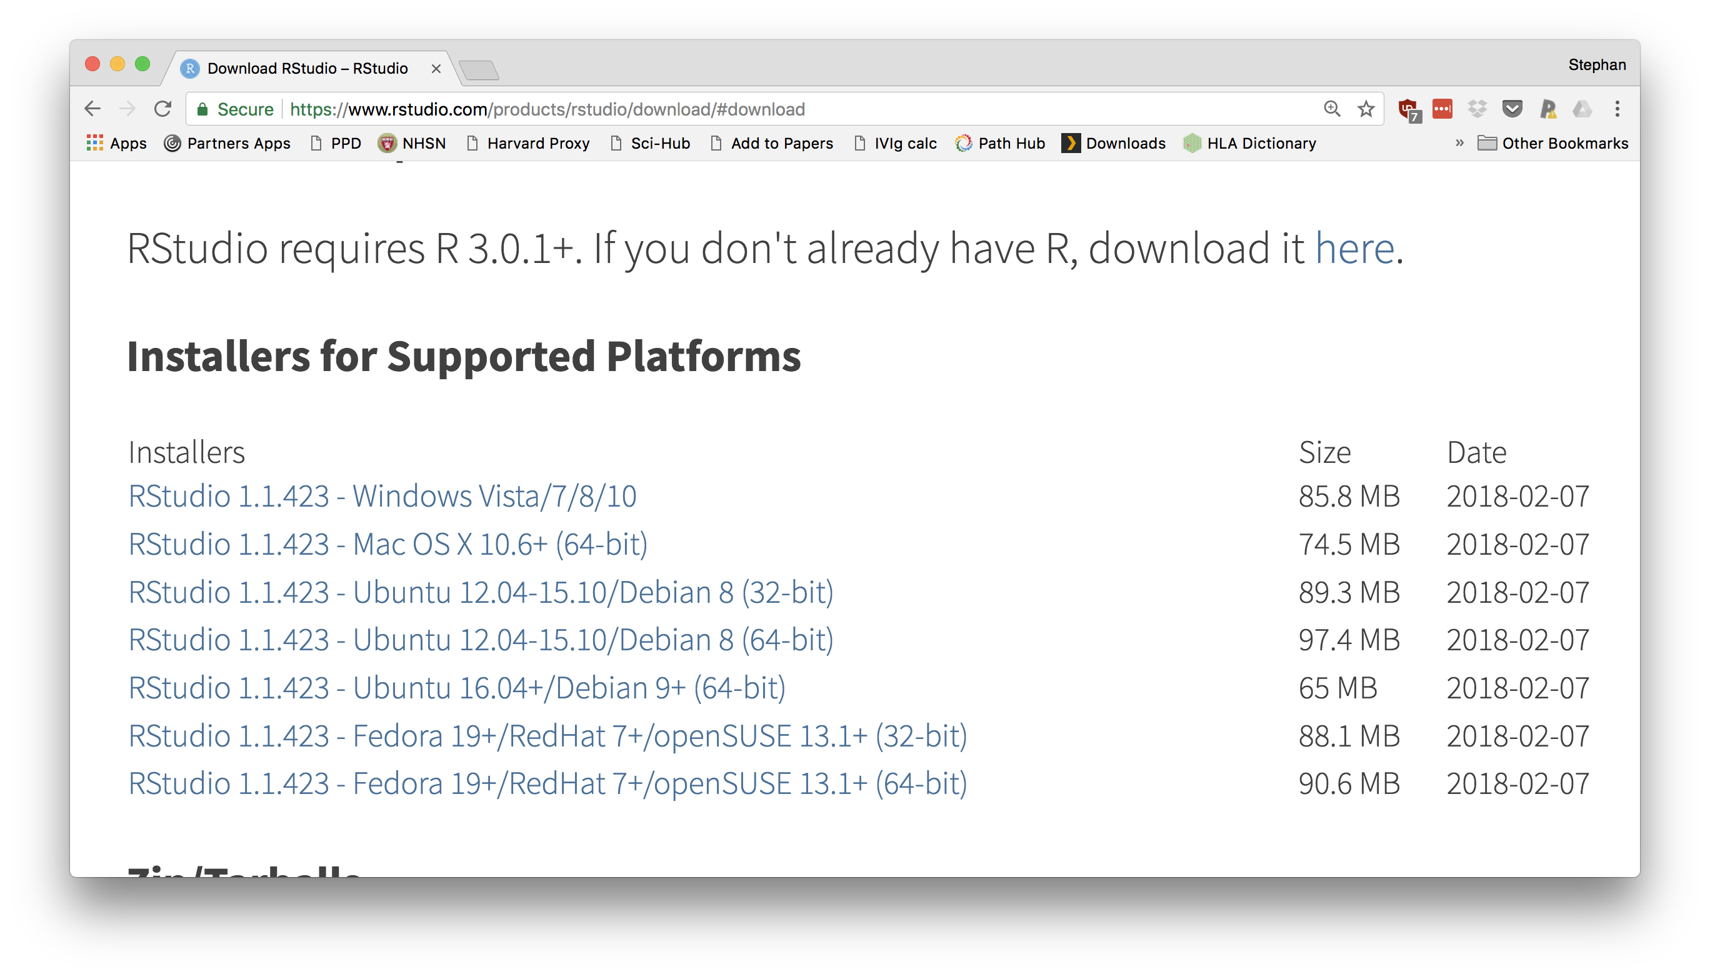
Reproducible Clinical Data Analysis with R and RStudio
Welcome to
Download RStudio from https://www.rstudio.com/download
Wireless network: phswifi3 not phspiaguest! Password: Your Partners Password

Slide 8
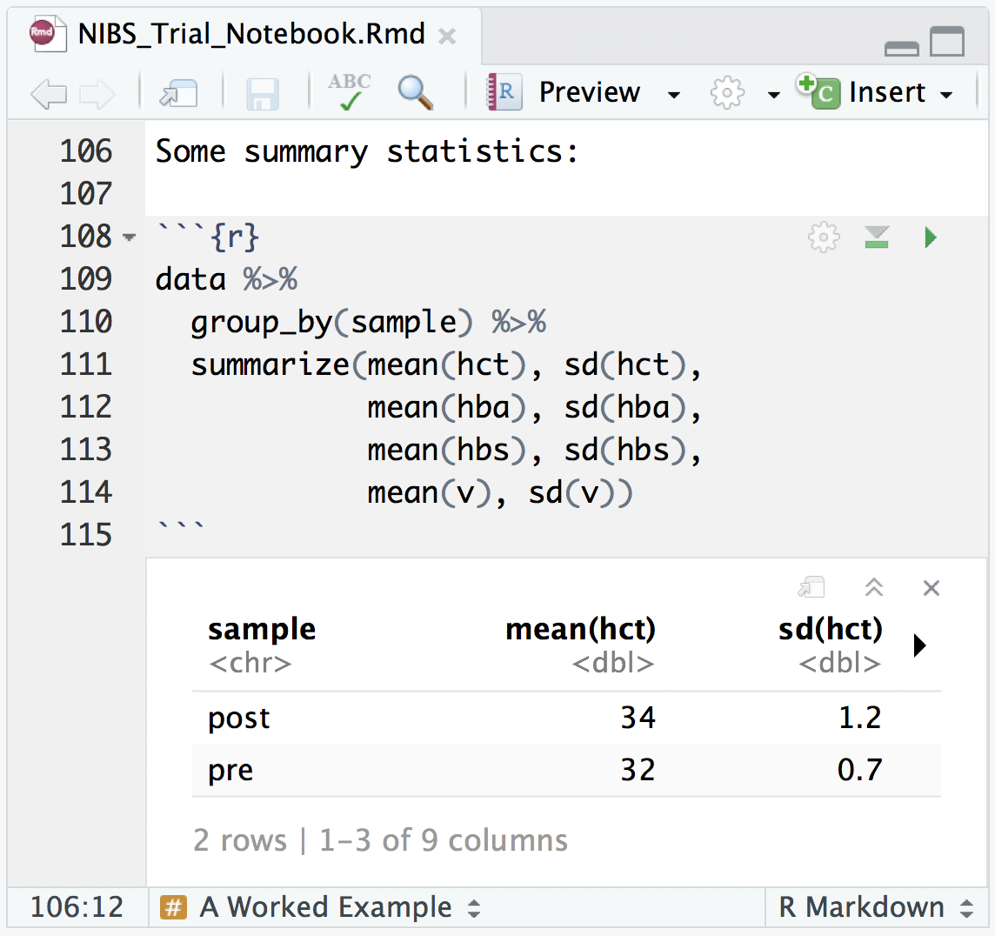
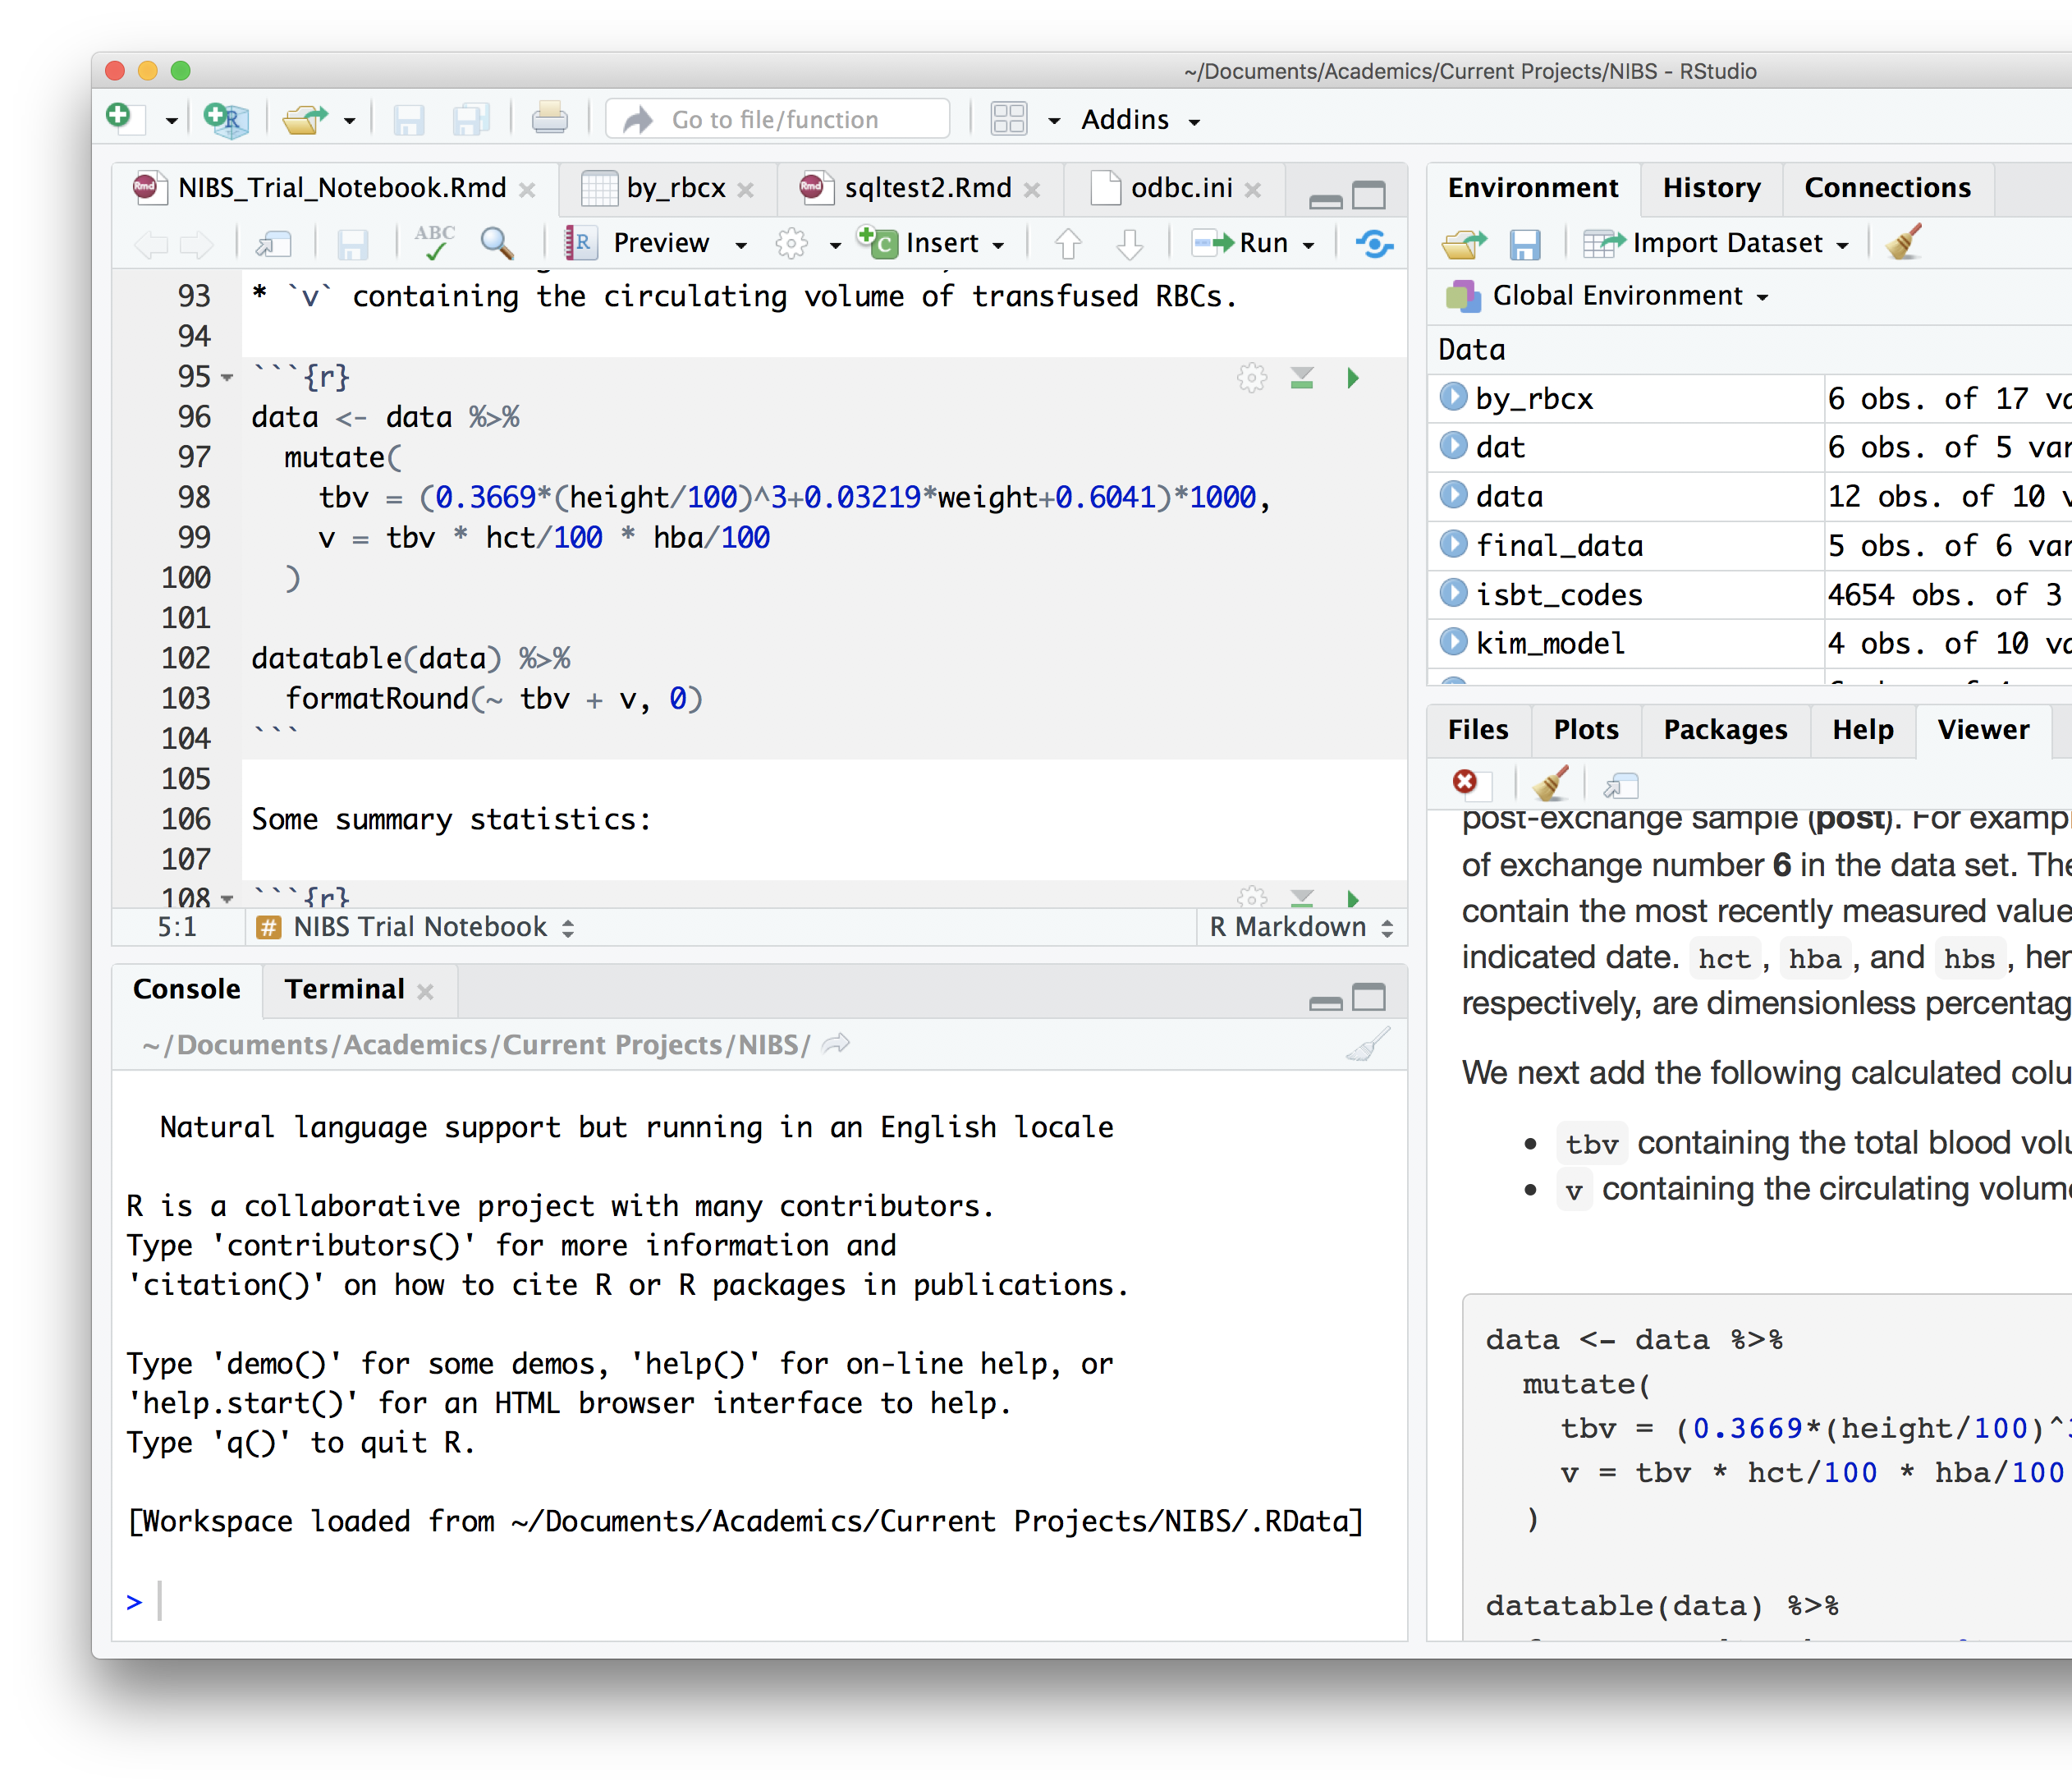
Reproducible Clinical Data Analysis with R and RStudio
Welcome to
Click to run all code chunks above
Wireless network: phswifi3 not phspiaguest! Password: Your Partners Password

Slide 9
Reproducible Clinical Data Analysis with R and RStudio
Welcome to
Click to run all code chunks above
Click to run code in chunk
Wireless network: phswifi3 not phspiaguest! Password: Your Partners Password

Slide 10
Reproducible Clinical Data Analysis with R and RStudio
Welcome to
Click to run all code chunks above
Click to run code in chunk
Wireless network: phswifi3 not phspiaguest! Password: Your Partners Password

Slide 11
Reproducible Clinical Data Analysis with R and RStudio
Welcome to
Click to run all code chunks above
Click to run code in chunk
Code result
Wireless network: phswifi3 not phspiaguest! Password: Your Partners Password

